Slide 1
Finance Transformation Programme (FTP)
Discovery Phase Roadshow Presentations
March 2020

Slide 2
Objectives of today
Quick recap on aims of the Finance Transformation Programme
Update on comprehensive work undertaken to understand how Finance functions and how we engaged with the University
Familiarise key Finance stakeholders with findings from the Discovery Phase
Inform about our next steps

Slide 3
Finance Transformation Programme
The University is embarking on an ambitious, large-scale initiative which will ultimately shape and enhance Finance’s processes and tools of the future
The
programme:
a managed, coordinated programme, that consists of multiple projects
CUFS Replacement/ Upgrade
Group Consolidation System
Strategic Procurement Review (SPR)
Expense Management
Projects
Invoice Automation
Management Information
Planning & Analysis
Reporting
Finance Vision & Objectives
Programme Management
Communication & Change Management

Slide 4
How have we engaged with the University?

Slide 5

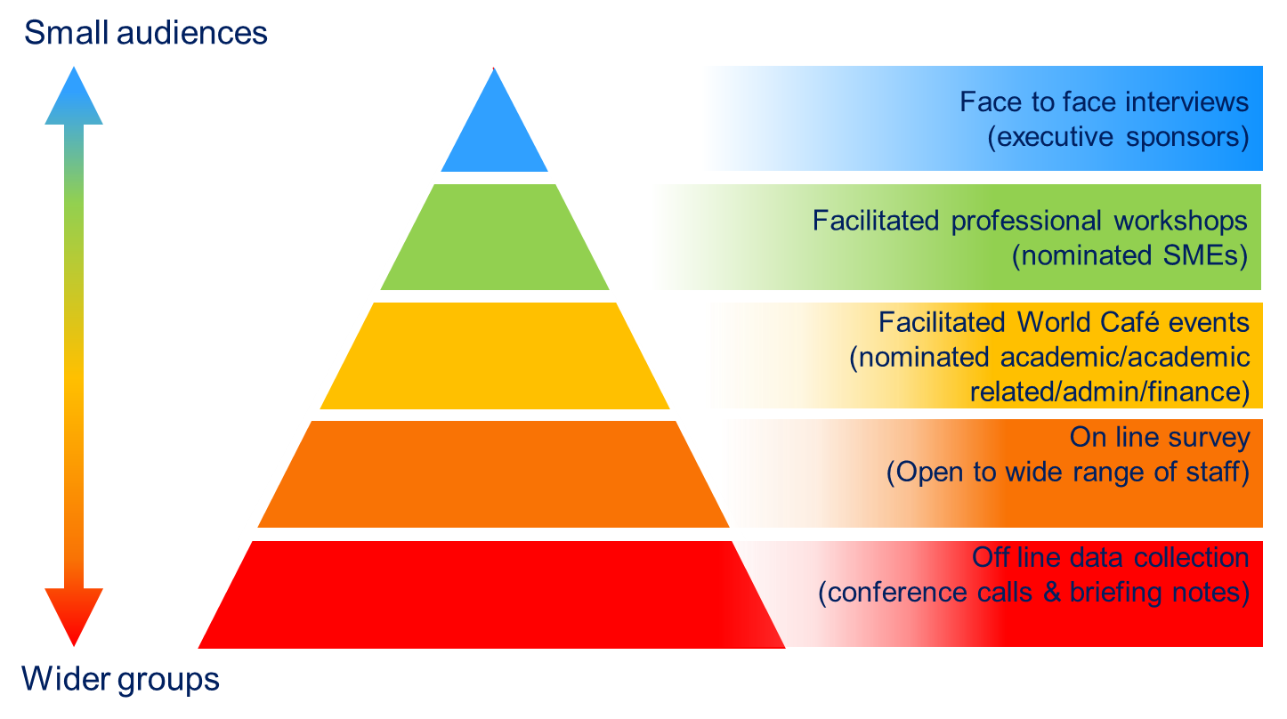





3. Stakeholder engagement
A range of stakeholder engagement events were organised to collect comprehensive feedback and identify major challenges, pain points and risks across the University within Finance
Engagement types
 | 308 attendees across all events
 | 5 world café events with 125 attendees
 | 30 process workshops attended by 133 people
 | 43 face-to-face interviews
 | 2 senior management team workshops
 | 1161 survey responses across 94 departments

Slide 6
How do people feel about finance?

Slide 7
Finance survey analysis
We received 1161 responses from across all eight schools and 94 departments. The survey was completed across four role categories; Academic/Research, Departmental or Central Finance staff, Professional Services staff (excluding finance staff) and ‘Other’.
42%
28%
17%
13%
*
* Excluding finance staff

Slide 8
Summary of comments by key themes
Percentage breakdown of comments relating to the five key themes
1%
Governance and control
17%
15%
People and organisation
Management information, data and reporting
26%
Systems and tools
41%
Processes and policies
The highest percentage of responses were focused upon processes and policies with over a third of all responses alluding to this theme. Comments were broadly around inefficiency, lack of transparency and manual effort being required.
Systems and tools were also readily discussed. Systems were described as unintuitive, outdated and time consuming to manage.

Slide 9
Identified opportunities in comments
Example quotes
The business opportunities identified by respondents were as follows:
“I would like to see more ready-to-use reports which are useful for management reporting.”
Five to ten years Professional Services staff, Unified Administrative Services
“CUFS is cumbersome, disparate, outdated”
One to two years, Professional Services staff, Non School Institutions
“Processes seem old and need to be refreshed–
Three to four years Professional Services staff, Non School Institutions
Systems identified under “system review”
CUFS and iProc
X5
Expenses
The most identified opportunity for the University from survey comments was around process improvement, simplification and standardisation.
Simplified and standardised reporting, clearer organisational alignment and a need for improved and more bespoke training and communications were also frequently called for.

Slide 10
Identified business needs in comments
Example quotes
The top five business needs identified by respondents were as follows:
“Often processes follow a strangled route and change regularly. It's hard to keep up with new procedures and they are not communicated well.” - Ten or more years, Academic/Research, School of Biological Sciences.
“There doesn't seem to be much linkage between the various elements of the Finance Division - we often end up sending the same information to different parts of the Finance Division.” Less than ten year Professional Services staff, Assistant staff, Unified Administrative Service
“I find the system that automatically deletes a supplier from the University purchasing system after a certain period of time without purchases very frustrating.”
Ten more years Academic/Research, School of the Biological Sciences
Simpler and consistent end-to-end processes were the greatest business need identified. This covered expenses, setting up and paying suppliers, general processes and procurement.
Clearly defined roles and responsibilities in Finance, communicated across the University was also requested frequently, indicating an underlying confusion around available support and channels in which to request it.
Systems identified under “user-friendly and simpler systems”
CUFS and iProc
X5
Expenses

Slide 11

Process satisfaction (1)
22%
26%
24%
45%
39%
44%
33%
35%
32%
206 out of 473 respondents indicated that they were extremely satisfied, or somewhat satisfied with reporting, which may reflect that some reports are tailored at a local level to meet end user needs.

Slide 12
Process satisfaction (2)
26%
24%
24%
39%
44%
44%
35%
32%
32%
134 out of 258 respondents indicated that they were extremely satisfied, or somewhat satisfied with applying for a grant/research income.

Slide 13
Discovery Phase Key Findings
Notes:
Louise and Nicola hand over to Stephen

Slide 14
FINDINGS FROM analysis (1)
Finance Processes are not user friendly
Limited ability to set financial targets and KPIs
.
End users
No KPIs
Process variations leading to inconsistent ways of working
Chart of Accounts structure is complex leading to risks and mistrust of information
Process variations
Complex Chart of Accounts
PROCESS AND PERFORMANCE
Fragmented processes
Reporting
Budgeting / Forecasting is manual, time intensive and not aligned
Chart of Accounts mapping can be difficult to analyse.
Manually intensive
Sub-optimal
Processes
Manually intensive processes
Lack of process optimisation across the end to end finance user journey

Slide 15
FINDINGS FROM analysis (2)
Extensive staff knowledge aids overcoming inconsistent processes
Key Person Dependency posing operational resiliency risks
Finance Knowledge
Operational Resilience
Risks
Financial organisation silos lead to duplication of processing and lack of visibility between schools/departments
Multiple financial systems which are not integrated and cause duplication of effort
Org Structure
silos
Complex Systems
Landscape
TECHNOLOGY, TOOLS, PEOPLE AND ORGANISATION
Best Practice
Complex
Reporting
Process
Limited best practice sharing and inhibited continuous improvement
Bespoke reporting which hinders decision making.
Complex decision making
Opaque Finance Activities
Complex and devolved structure limits quick decision making
Lack of full visibility of finance activities across the University

Slide 16







High Level As-Is Operating Model: Capability split across the University
This is a high-level, generic overview of the Level 1 capability process split between the Finance Division, Departments and School Offices. This diagram may vary for certain individual Departments.
Finance Division
Departments
School Offices
No. of suppliers
70k
Audit and Assurance
Advisory
No. of fund sources
15k
Accounts Payable
Accounts Receivable
Budgeting and Forecasting
No. of customers
21k
Cash Management
No. of AR invoices
+170k
Fixed Assets / Inventory
General Ledger / Chart of Accounts
Insurance
Donations
No. of trust funds
868
PAS
Estates
No. of AP invoices
+450k
Payroll and Pensions
Reporting
Research grants
No. of cost centres
35k
Strategy, policy and guidance
No. of active grants
8.6k
System admin / Helpdesk
Tax
Training*
Treasury
*Formal training courses (face-to-face and online) delivered by Finance Division. Training also occurs in Schools and Departments but in a less formal way.

Slide 17
As-Is Operating Model: High Level Capability Assessment
The finance capabilities below were assessed by looking at system, process and people perspectives. Overall, they can be largely improved
ADHERENCE TO GOOD PRACTICE:
High
Medium
Low
Absent
Accounts payable
Accounts receivable
Cash management
GL / CoA
Pensions
Payroll
(Inc. off payroll)
Credit cards
Expenses management
Credit control
Customer setup / maintenance
Direct debit collections
Bank reconciliation
Creating and posting journals
Maintain pension records
Pay employees
International payments
Process invoices
Invoicing
(internal & external)
Bad debt and write-offs
Petty cash
GL maintenance
Administer pension schemes
Invoice payments
Refunds
Receipting
Sales - online,
EPOS, other systems
Reporting on pensions
Overtime
Fixed Assets
Treasury
Supplier setup / maintenance
Research grants
Register / capitalise asset
Cash monitoring / forecasting
Budgeting and forecasting
Starters, leavers and changes to pay
PAS / Estates
Costing grant applications
Contract and Pre-Award
Asset tagging
Currency trading and hedging
School and dept. budgeting
Chest allocation
Off payroll workers
Commercial property income
Capital projects
Budget and set up grant
Administer and close grants
Asset verification
Administer Endowments
Admin funds budget & forecasting
Calculate net pay
Residential income
Tenancy deposit accounting
Tax
Asset adjustments
Administer internal loans & shared equity
Setting course fees
Capital planning
Auto enrolment
Donations
Helpdesk
Compliance
P11D
Bond accounting
Insurance
Log and respond to query / issue
Payroll reconciliations
Receiving donations
Corporation tax
International tax
Reporting
Claims handling
Management
and review
Processing donations
VAT
Reporting to funding bodies
Month-end reporting
Audit
System Admin
Policy / Guidance
Coordinate external and internal audits
Reporting donations
Maintain / upgrade systems
Inventory
Trust fund statements
Annual financial statements
Setting policy
Maintain financial procedures
Overheads
Fin. Training
Identification and stock take
Manage
inventory
Bespoke / ad-hoc internal reporting
Capital reporting
Strategy
Master Data Management
Research grant overheads
Train staff
Issuing/
Returning
Statutory reporting
Financial modelling
Define Finance strategy
Manage functional performance
Continuous Improvement
ICC
Vocational and professional training
Portfolio Management

Slide 18
Current systems landscape
The current As-Is systems landscape is complex, outdated and does not full meet the end-user needs.
A large percentage of systems require manual transfer of data flows, resulting in substantial manual workflows to carry-out Finance processes
Accounts Payable
VOIP
Unified Software
Payroll & Pensions
Barclaycard
Portal
UPS
+50
Individual software
packages
+120
Modules, application variations, spreadsheets†
Contracts register
Advanced
PS Pension System
Cheque printing
InTend
Barclays.Net
Pension
spreadsheets
APEX
TES
Reporting
Alma
EDRS
UFS Interface
Payroll and Pensions interface tool
COGNOS
Alteryx
Amicus
APT
JProc
Centaur
Customer invoice form
eConnect
CHRIS
TAS
CAMSIS
CRM
CUFS
Tempora
Onestream
Digitickets
Tableau
Reporting
spreadsheets
Accounts Receivable
Gladstone
EPOS
(K3, MERAC)
TOAD
AP
AR
CM
Treasury, Insurance
& Overheads
PPMS
TRAC
Treasury
spreadsheets
Olympus
eSales
FA
GL
Grant
Config-
snapshot
Insurance
spreadsheets
Shopify
Sage
WPM
(Cudar &
Generic)
Inv.
IPROC
Purc.
CRUK Access
database
Elements
AR
forms
PMS
Hyperdata
Scanner Booking
Access database
Uniware
EPOS
Budget Calc.
Grants
spreadsheets
Key – How the system transfers data to/from CUFS*:
■ Automated
Automated by manually triggered
■ Manual keying
* If system does not link to CUFS, the key refers to how the system links to the next system in the data flow or, if it is a system at the end of the data flow, how the previous system links into it
Webcom
Planet
T4C
Lodge
ROO Portal
CUFSe
Research Dashboard
PAS / Estates
Propman
Oracle
Web ADI
RCO Database
Grants
Systems Link
BES
MICAD
Webtool
CMS
Funders Portal
Dataloader
X5
Construction-
line
Forecasting/
costing
spreadsheets
Event Loader
RGEA
GL/CoA
Spreadsheets
Finance
Lookup
Budgeting/Forecasting
Corp. Planner
GL/CoA/Fixed Assets
Heat
Kace
† This does not include the numerous Excel spreadsheets maintained and used by teams for reporting

Slide 19
Potential future systems landscape at the University
There is significant scope for rationalising the systems landscape into a core finance system with best of breed system/s integrated into core system.
Accounts Payable
VOIP
Unified Software
Payroll & Pensions
Barclaycard
Portal
UPS
Contracts register
Advanced
PS Pension System
Cheque printing
InTend
Barclays.Net
Pension
spreadsheets
APEX
TES
Reporting
Alma
EDRS
UFS Interface
Payroll and pensions interface tool
COGNOS
Alteryx
Amicus
APT
JProc
eConnect
TAS
Centaur
CAMSIS
Customer invoice form
CHRIS
CRM
CUFS
Tempora
Onestream
Digitickets
Tableau
Reporting
spreadsheets
Accounts Receivable
Gladstone
EPOS
(K3, MERAC)
Treasury, Insurance
& Overheads
PPMS
AP
AR
CM
TRAC
TOAD
Olympus
eSales
FA
GL
Grant
Config-
snapshot
Treasury
spreadsheets
Shopify
Sage
WPM
(Cudar &
Generic)
Inv.
IPROC
Purc.
Insurance
spreadsheets
Elements
AR
forms
PMS
Hyperdata
Scanner Booking
Access database
Uniware
CRUK Access
database
Grants
spreadsheets
Webcom
Planet
T4C
Lodge
Budget Calc.
CUFSe
Research Dashboard
PAS / Estates
Propman
Oracle
Web ADI
RCO Database
Grants
Key:
System that can be part of a new integrated finance system landscape
Application to be replaced, which is not part of finance system landscape
Retained application
Systems Link
BES
MICAD
Webtool
X5
CMS
Funders Portal
Construction-
line
Forecasting/
costing
spreadsheets
Dataloader
Event Loader
RGEA
GL/CoA
Spreadsheets
Finance
Lookup
Budgeting/Forecasting
GL/CoA/Fixed Assets
Heat
Kace

Slide 20
Next Steps
High Level Plans
Notes:
Survey – a lot of people engaged

Slide 21
Building the FTP Business Case
Quick Wins and early deliverables
FTP Business Case
Discovery Phase
Projects
Management Accounting, Planning & Budgeting
Business Information
Strategic Procurement Review
Pre-Approval Phase
Procurement/Purchasing
Core Financials
(CUFS Replacement)
ourcambridge
Expense Management
CUFS Upgrade
HR Transformation
Shared Work Streams
Systems, Communications, Data,
Change Management, Training
Research Costing
Jul – Dec 2019
Jan – May 2020
June 2020
21

Slide 22
Communications
Finance Transformation Programme Communications
Raise awareness of FTP to the University and key audiences
Keep the programme, its progress and achievements in the University’s conscience through timely and targeted updates
Engage, consult, reassure, transparency
Create opportunities for two-way communication
    Current key focus: communicating results of Discovery Phase.

Slide 23
Indicative High Level
Programme Plan
ourcambridge
‘To-be’ design of functionality, processes, organisation, reporting & data flows
Procure and develop
new systems
Business data & processes redesign
Procure and develop new systems
Testing and no-go criteria
Development, testing, training of processes, organisation and reports
Implementation of systems, processes and reporting
Design Phase
Develop Phase
Deliver Phase
Business Case Approval
Projects
Procurement/purchasing
Management Accounting, Planning & Budgeting
Expense Management System
Core Financials (CUFS Replacement)
Business Information
CUFS Upgrade

Slide 24
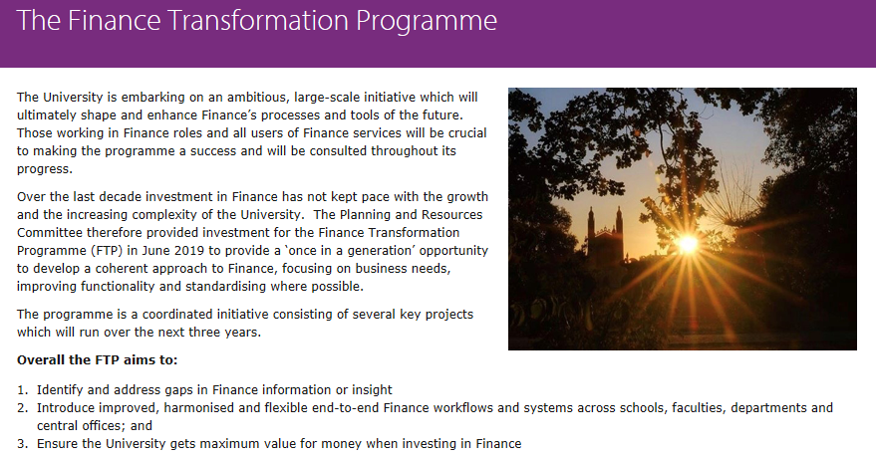


Internal Communications and Two-Way Engagement
Website for further information about FTP and its key projects
News and updates about the programme and key projects regularly posted to the site
Creation of FTP Yammer group
Communications planner across the FTP programme and key projects
Have your say on the future of Finance!
Two-way engagement is key we have listed anticipated FAQs
Employees encouraged to submit any queries via FTP mailbox on the website or email:
ftprogramme@admin.cam.ac.uk
Targeting the University's internal communications channels including the staff website, Finance intranet, ourcambridge, Knowledge Bites and Yammer
Yammer

Slide 25
Any questions?

