Slide 1
Chest Allocation (Project Pectus) Methodology and Reporting Changes
Finance Division

Slide 2
Aim of the changes to Chest Allocation
Full on-system budgeting with a consistent approach for both Chest and non-Chest income and expenditure within CUFS.

Slide 3
Methodology
Previous Process
Allocations of Chest funding only appeared in the accounts as a budget called Allocation using expenditure transaction codes as debits.
New Process
Each month the Allocation is posted in CUFS as actual “Chest Income” using the phasing determined by Schools/Departments.
Both the budget field and actual Chest Income are posted using GP** income transaction codes as credits.

Slide 4
Changes for Departments
Departmental reporting showing income changed to include the actual Chest Income postings. The impact of this may be that any local reporting would need to be adapted.
Departments now have access to a smaller number of more flexible Cognos reports.
We are not anticipating any changes to departmental day-to-day processes.

Slide 5
Benefits for Departments
Even if you do nothing else – “Chest Allocation” is now received as actual income.
Consistency - all departmental activity reflected as Actuals.
Use of the Plan budget in CUFS is encouraged to encompass all activity where material.
The Plan budget can be used to upload against Chest sources of funds for expenditure, which does not have to match to the Chest Income allocation amount, e.g. allowing plans to spend down reserves.
Enabling reporting against Department Plans in a more direct way.

Slide 6
Full picture
This project brings together a number of new initiatives which together will allow a full budgeting process
Cost centre categorisation and cost centre owners. (allows more tailored reporting)
Uploading Plan for Chest and Non Chest
Chest Allocation showing as actual income is more logical for non finance staff
Together this all allows for a fully functioning budgeting and monitoring system

Slide 7
New reports

Slide 8
GL Journal Transactions
Available in Cognos, this General Ledger report provides detailed General Ledger Journal line information.
This report has a variety of optional fields, allowing users to customise the output to better suit their requirements and see information about source transactions for the journal lines if required.
This report is intended to be used as a working report, and as such does not contain any header, footer, or summary information in order to ease manipulation of the output to meet user needs.
This report is intended for use by Departments, Schools and Central Finance. This report uses the standard security model, restricting information returned to only Departments or Schools the user has been granted access to.
This report defaults to Excel, but can provide output in all standard formats (including PDF and HTML).

Slide 9
GL Journal Transactions – default output
In Excel a workbook containing two worksheets will open entitled:
GL Journal Transactions
Report Information
The GL Journal Transactions tab shows journal line details for each entry that matches the report criteria.
The GL Journal Transactions tab includes the following default fields:
GL Date
Period Name
Department Code
Cost Centre Code
Source of Funds Code
Transaction Code
Journal Line Description
Accounted amount
Notes:
The choice of account string order is deliberately set to match how people have to code up items

Slide 10
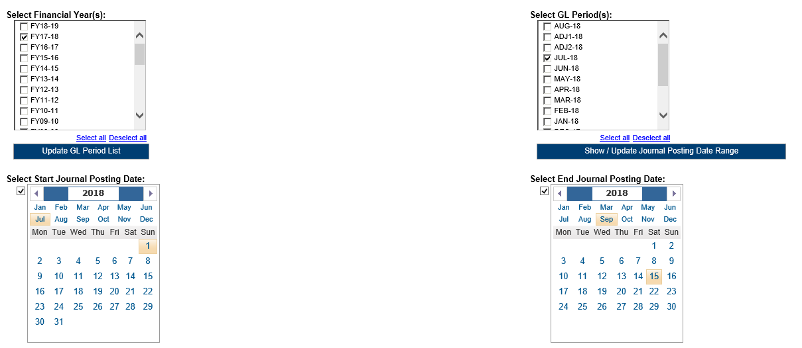
GL Journal Transactions – parameter screens
Date parameters can be used to select the date range to be covered in the report

Slide 11
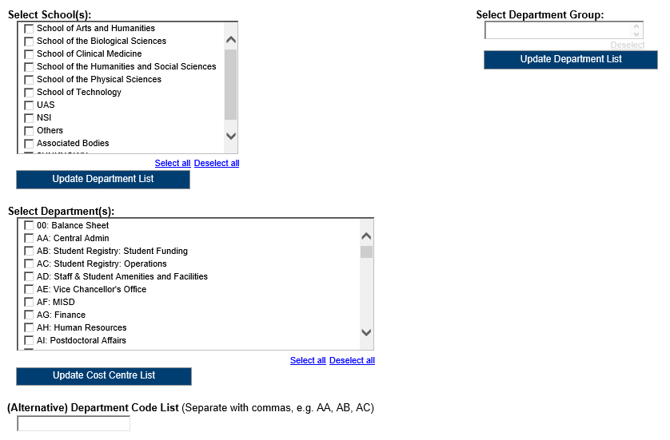
GL Journal Transactions – parameter screens
The report can be run for Departments, Department Group, Schools, or even across the whole University.
A list of Department codes can also be typed in separated by commas.
Notes:
If users only have access to one Dept they will only see one School option and just that Department; the display adapts to user rights
If nothing is selected users will get all the Departments you have access rights to

Slide 12
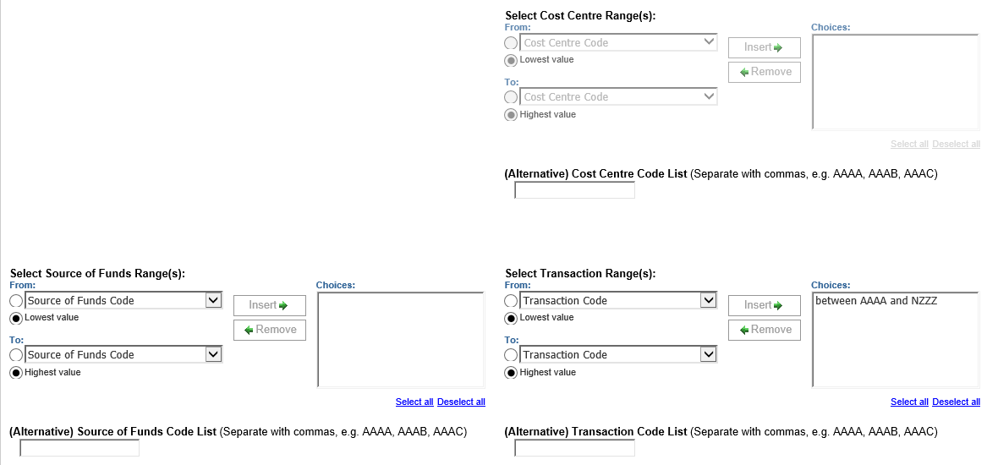
GL Journal Transactions – parameter screens
Account Segment Parameters:
Cost Centre(s) (optional)
Source(s) of Funds (optional)
Transaction(s) (optional)
Results can be restricted further by entering ranges for Account Code Segments, or by typing in lists of values separated by commas.
Notes:
Note the default setting is for transaction codes just covering Income and Expenditure (i.e. AAAA to NZZZ)

Slide 13
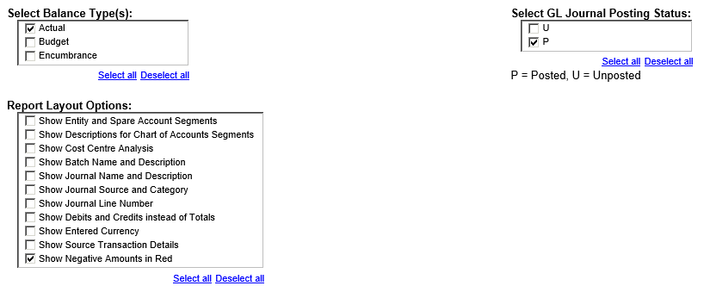
GL Journal Transactions – parameter screens
Output Parameters:
Balance Type(s) (optional)
GL Journal Posting Status (optional)
Report Layout Options (optional)
The output received from the report can include different journal types and statuses, and additional fields can be shown on the output by selecting various layout options.
Notes:
Default choices are preselected to those most commonly required:
Actual, Posted, Show negative numbers in red
Use the Report layout options to get additional columns
NB: Cost Centre Analysis will return the 6 Cost Centre category fields

Slide 14
GL Budget to Actual
Available in Cognos, this General Ledger report provides summary General Ledger posting information.
This report has a variety of optional fields, allowing users to customise the output to better suit their requirements and see information about the current period or YTD vs Annual variances.
This report is intended to be used as a working report, and as such does not contain any header, footer, or summary information in order to ease manipulation of the output to meet user needs.
This report is intended for use by Departments, Schools and Central Finance. This report uses the standard security model, restricting information returned to only Departments or Schools the user has been granted access to.
This report defaults to Excel, but can provide output in all standard formats (including PDF and HTML).
Notes:
Note: For those who use the CUFS BtA report the Budget field will be changed to default to PLAN [Paul H to confirm/action]

Slide 15
How the new report looks (Budget to Actual example)
17/18
Cost Centre | Source of Funds | Transaction | Annual Budget | Budget YTD | Actual YTD | Variance YTD
XXCC | ABAA | AAAC | 39,000 | 6,500 | 6,730 | (230)
XXCC | ABAA | AAAD | 45,000 | 7,500 | 7,187 | 313
 |  |  | 84,000 | 14,000 | 13,917 | 83
18/19
Cost Centre | Source of Funds | Transaction | Annual Plan | Plan YTD | Actual YTD | Variance YTD
XXCC | ABAA | GPAA | (84,000) | (14,000) | (14,000) | 0
XXCC | ABAA | AAAC | 39,000 | 6,500 | 6,730 | (230)
XXCC | ABAA | AAAD | 45,000 | 7,500 | 7,187 | 313
 |  |  | 0 | 0 | (83) | 83
Notes:
Post Pectus:
The Plan YTD shows the Chest allocation as actual income (negative/credit) using transaction code GPAA
The budgeted expenditure (AAAC and AAAD) equal this income as the Chest budgets have been set to balance
AAAC is showing actual expenditure exceeds budget
AAAD is showing actual expenditure is less than budget
Overall a positive variance (i.e. some income left over)
In the ‘old’ world the Variance YTD figure was the key one to review to assess the variance for the year – in this example showing a favourable variance of 83 (shown as a positive number)
Post Pectus the Actual YTD figure is the key one, same example showing the 83 as a negative (i.e. income exceeds expenditure)

Slide 16
GL Budget to Actual – default output
In Excel a workbook containing two worksheets will open entitled:
GL Budget vs Actual
Report Information
The GL Budget vs Actual tab shows budget, actual and variance summaries for each account combination that matches the report criteria.
Default Output Columns
The GL Budget vs Actual tab includes the following default fields:
Cost Centre Code
Source of Funds Code
Transaction Code
Annual Plan
Plan YTD
Actual YTD
Variance YTD

Slide 17
GL Budget to Actual – parameter screens
Accounting Date Parameters:
Financial Year (optional)
GL Period (mandatory)
The report must be run for a single GL Period.
Notes:
Choosing a FY will limit the GL Period drop down options.
GL periods are listed with the most recent at the drop of the dropdown list

Slide 18
GL Budget to Actual – parameter screens
Organisation Parameters:
School(s) (optional)
Department Group (optional)
Department(s) (optional)
Note: Your level of access in Cognos will determine which Departments you can see information for.
The report can be run for Departments, Department Group, Schools, or even across the whole University.
A list of Department codes can also be typed in separated by commas.
Notes:
As with the Transaction report users will only see what they have access to

Slide 19
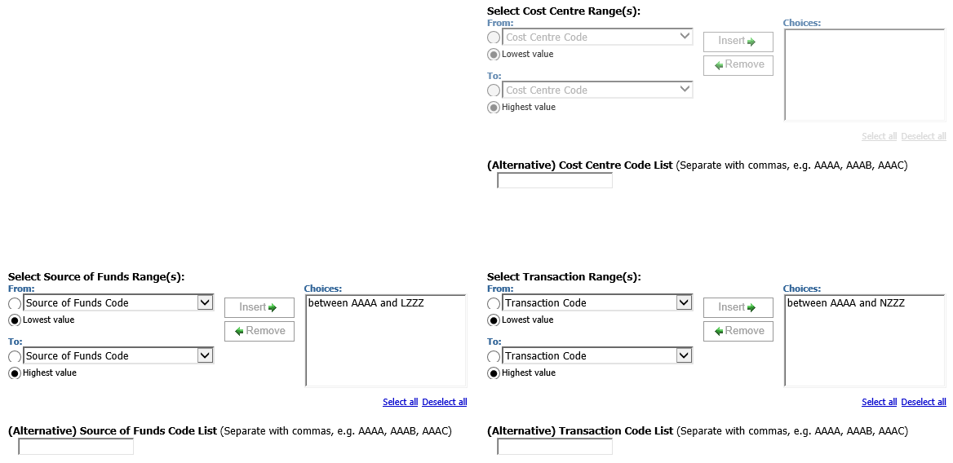
GL Budget to Actual – parameter screens
Account Segment Parameters:
Cost Centre(s) (optional)
Source(s) of Funds (optional)
Transaction(s) (optional)
Results can be restricted further by entering ranges for Account Code Segments, or by typing in lists of values separated by commas.
Notes:
Defaults are set to cover just core GL sources of funds (AAAA to LZZZ) and only Income and Expenditure codes (AAAA to NZZZ)

Slide 20
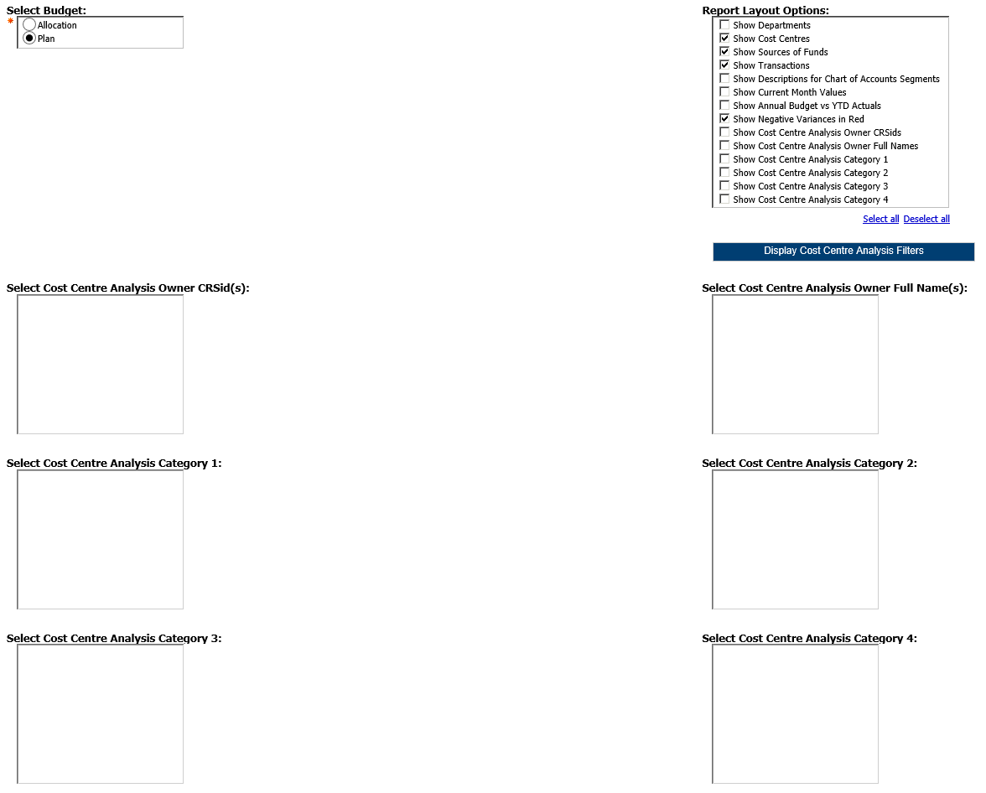
GL Budget to Actual – parameter screens
Output Parameters:
Budget (mandatory)
Report Layout Options (optional)
The output received from the report can show additional fields by selecting various layout options and can be filtered using Cost Centre Analysis fields.
Notes:
The boxes at the bottom will only show, as appropriate, if the user selects one or more of the Show Cost Centre Analysis... options in the Report Layout Options

Slide 21
GL Financial Summary
Available in Cognos, this General Ledger report provides summary General Ledger posting information.
This report has a variety of optional fields, allowing users to customise the output to better suit their requirements and see information about Cost Centre Analysis and an Income and Expenditure breakdown.
This report has two available outputs, one is intended to be used as a working report, and as such does not contain any header, footer, or summary information in order to ease manipulation of the output to meet user needs. The other is intended to be used as a presentation report, and contains the additional information.
This report is intended for use by Departments, Schools and Central Finance. This report uses the standard security model, restricting information returned to only Departments or Schools the user has been granted access to.
This report defaults to Excel, but can provide output in all standard formats (including PDF and HTML).

Slide 22
GL Financial Summary – default output
In Excel a workbook containing at least two worksheets will open entitled:
GL Financial Summary
Report Information
Additional worksheets for each Department will open if the Show Departmental Breakdown layout option is selected.
In PDF a single report will be displayed:
Financial Summary
Notes:
The layout shown here is for 2017/18 or earlier years.
Warning: If opting to run the report as a PDF (click on the “Run” arrow rather than the report name), do not select the addition of too may extra columns if you want the report to be legible!

Slide 23
GL Financial Summary – default output (17/18)
Default Output Columns
The GL Financial Summary tab includes the following default fields:
Source of Funds Code
Source of Funds
Annual Chest Allocation
Balance b/f
Budget YTD
Income YTD
Expenditure YTD
Surplus / Deficit
Overdrawn / Cash in Hand
Money on Deposit
CUEF
Other Investments
Total
Balance Sheet Entries
Reconciliation to CUFS
Revaluations in Year
Notes:
The item in red will only appear in 2017/18 or earlier years

Slide 24
GL Financial Summary – output (18/19)
The Chest Allocation is shown as income along with any other income (e.g. trading)
The Annual Chest Allocation is there for reference only
The surplus/(deficit) is shown in column 4
If the result is a positive this indicates a surplus (income exceeds expenditure), a negative result shows a deficit (expenditure exceeds income)

Slide 25
GL Financial Summary – parameter screens
Accounting Date Parameters:
Financial Year (optional)
GL Period (mandatory)
The report can be restricted to a particular Financial Year, and must be run for a single GL Period.
Notes:
Choosing a FY will limit the GL Period drop down options.
GL periods are listed with the most recent at the drop of the dropdown list

Slide 26
GL Financial Summary – parameter screens
Organisation Parameters:
School(s) (optional)
Department Group (optional)
Department(s) (optional)
Note: Your level of access in Cognos will determine which Departments you can see information for.
The report can be run for Departments, Department Group, Schools, or even across the whole University.
A list of Department codes can also be typed in separated by commas.
Notes:
As with the previous reports users will only see what they have access to

Slide 27
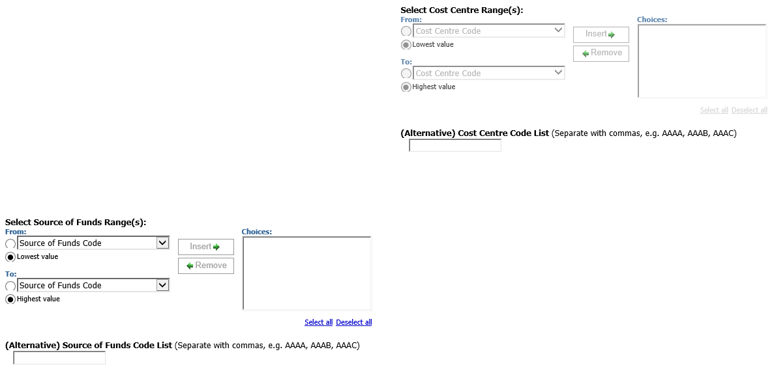
GL Financial Summary – parameter screens
Account Segment Parameters:
Cost Centre(s) (optional)
Source(s) of Funds (optional)
Results can be restricted further by entering ranges for Account Code Segments, or by typing in lists of values separated by commas
Notes:
Defaults to include all cost centres and all sources of funds

Slide 28
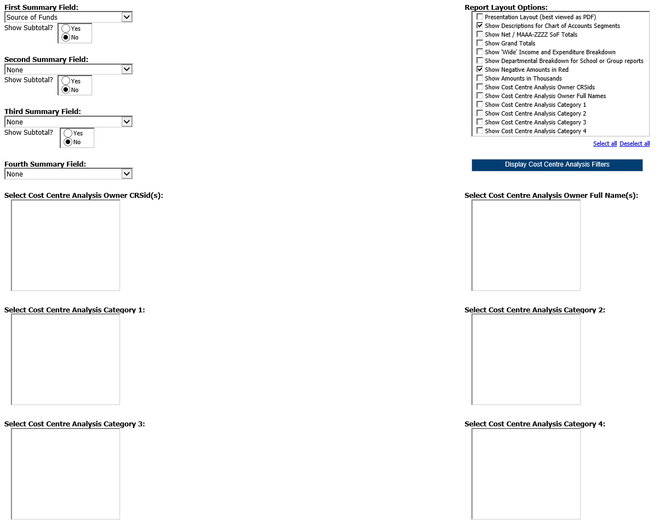
GL Financial Summary – parameter screens
Output Parameters:
Up to four Summary Fields (optional, with optional subtotals)
Report Layout Options (optional)
The output received from the report can be grouped with up to four summary fields, and additional fields can be shown on the output by selecting various layout options. The output can also be filtered by Cost Centre Analysis fields.
Notes:
The Summary Field options are:
Dept
Cost Centre 3 letter code
Cost Centre
Source of Funds
Source of Funds Group (i.e. high level summary used for Green books such as Trust Funds)
Source of Funds Category (i.e. mid level summary used for Planning such as Trust Funds Spendable)
The Report Layout Option “Show Departmental breakdown fro School or Group reports” will produce a multi-tabbed report: one covering all and then a tab for each Dept

Slide 29
Summary of reporting Changes
Make use of Plan to get the most out of your reports
Three core flexible GL reports available now
Departmental (Shared) Reports > GL Reporting
GL: Budget to Actual
GL: Financial Summary
GL: Journal Transactions
Other variants of these reports will be retired during 2018/19
Contact fsg.system.support@admin.cam.ac.uk with report feedback

Slide 30
Cognos reports
Notes:
Use this section if you want to explain how to save versions of the Cognos reports with pre-set parameter choices other than the defaults

Slide 31
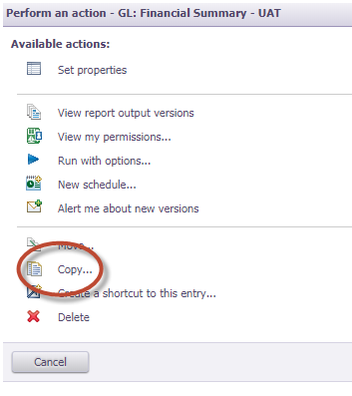
Cognos report view
Create a copy of a report view of the report and copy it into one of your folders
Optional: Give the report a new name.
Click on ‘My Folders’, or click on ‘Select another location’ and navigate to a folder where you have permission to store a report.
Click on ‘Ok’ to finish

Slide 32
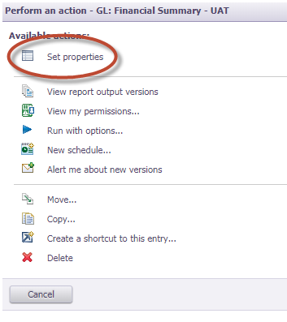
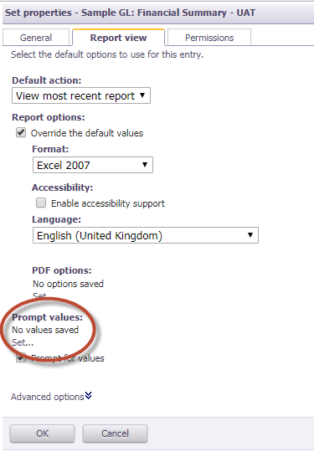
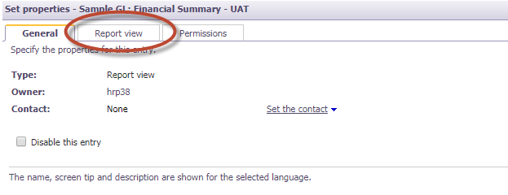
Cognos report view
Set up the defaults for the report
1
3
2

Slide 33
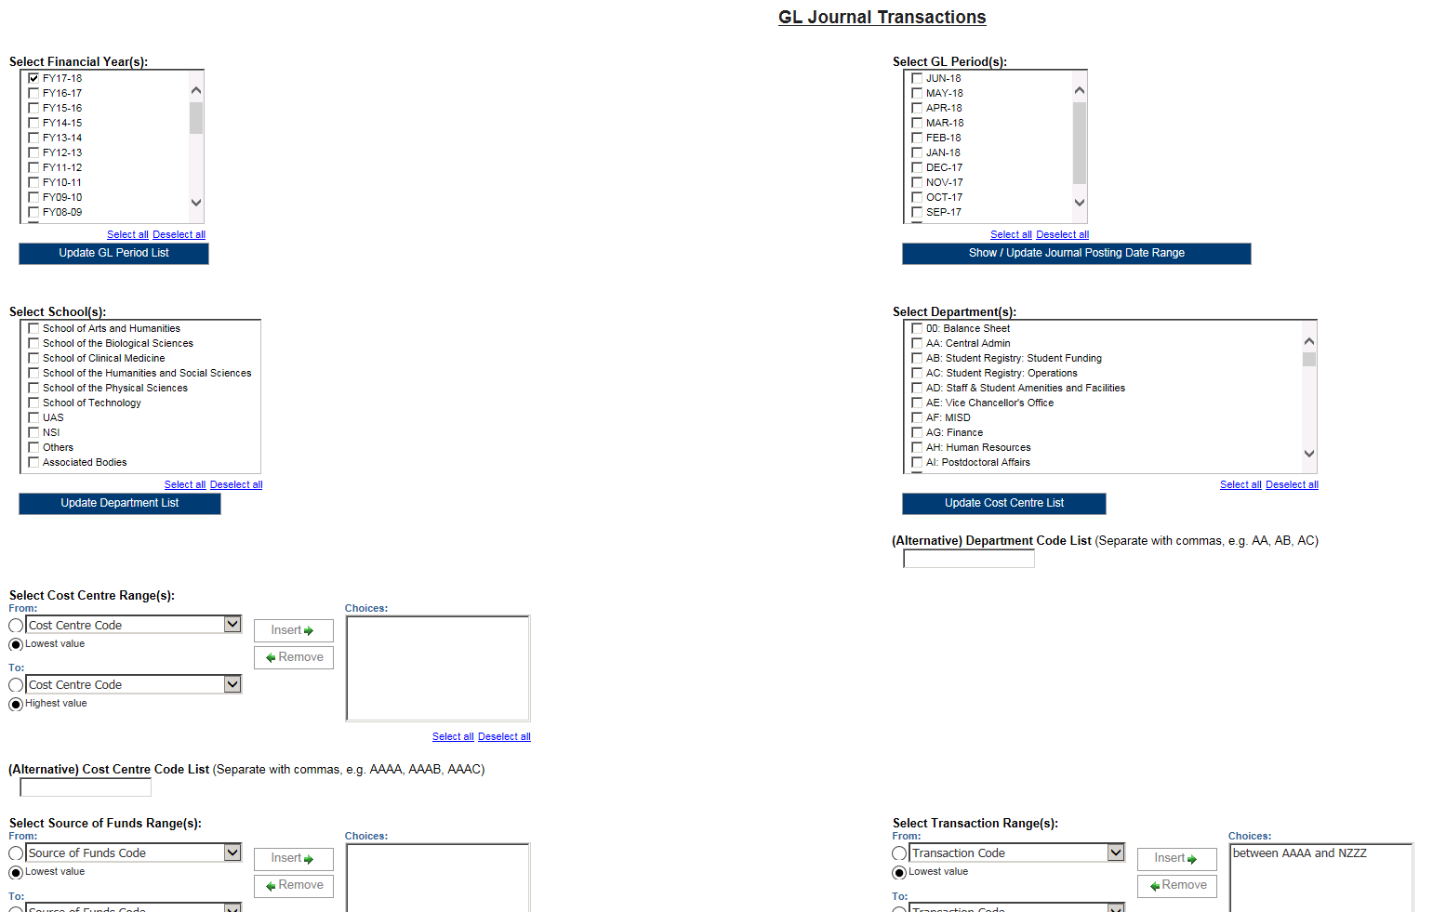
Flexible Cognos reports
Notes:
Reminder: Multiple field choices to allow the reports to be run for own needs

Slide 34
Any questions?

Slide 35
Project team
Claire Cahill (SAH)
Paul Humphreys (FSG)
Mike Sinclair (C&RA)
Sarah McCreary (FP&A)
Paul Bloomfield (FP&A)
Helen Parker (Training)
Lucy Harney (Director’s Office)

